Slide 1
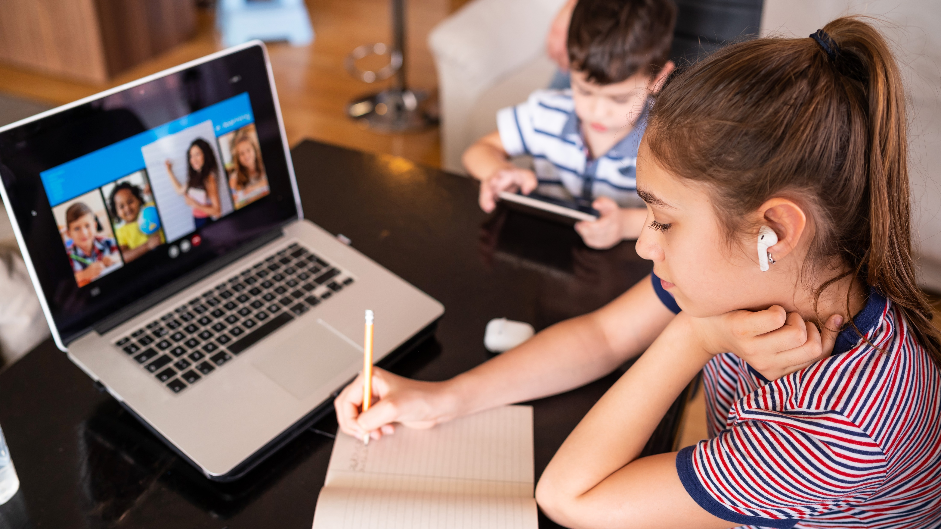
Effective Integration of Facebook with Education

Slide 2

Quick overview of today’s session

Slide 3
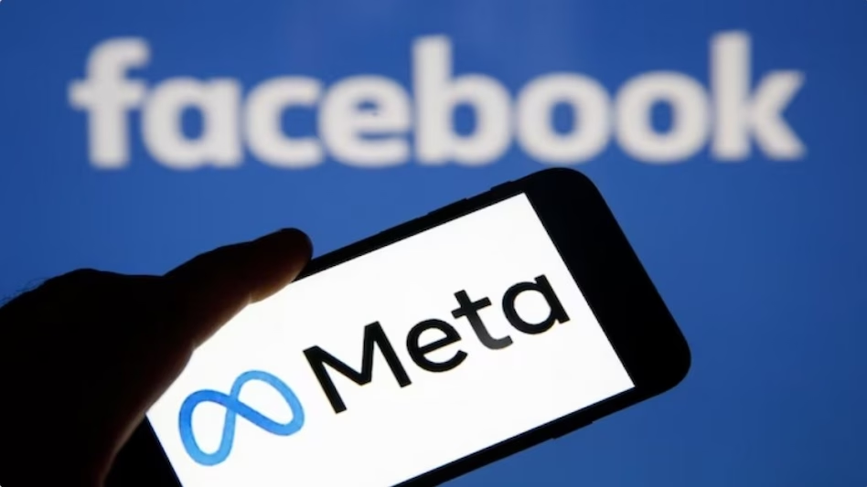
Quick Overview
About Facebook
Advantages of Facebook
Disadvantages of Facebook
Can Facebook be used in education, if yes?
How Facebook can be integrated with education
Benefits of Facebook in education
Use of Facebook during pandemic
Ways to stay safe while integrating Facebook with education.
Examples

Slide 4
1. About Facebook
Social networking website
Started in 2004.
2.9 billion monthly active users
India has 314 million users.
39-billion-dollar net profit in 2023
Different ways of using Facebook: - videos, content, stories, content, poll, live, reel, receiving calls, receiving WhatsApp messages, tagging people-place-business partner etc.

Slide 5
2. Advantage of Facebook
Networking
Massive user base
Global platform
Available in more than 70 languages
Great marketing tool
Educational tool
Cost effective
Integration with other platforms- messenger, WhatsApp, Instagram
Great tool to know about new people, place, culture etc.
Very fast
Spontaneous

Slide 6
3. Disadvantages of Facebook
Effect on physical health- obesity and eye problem.
Impact on sleep
Impact on attention span
Exposure to inappropriate content
Impact on mental health-loneliness and depression
Unrealistic expectations about body image, relationships etc.
Digital amnesia /google effect.

Slide 7
4. Can Facebook be Integrated with education ?
YES

Slide 8
5. How Facebook can be Integrated with Education
Information sharing- study material, educational videos & content
Networking: teacher- student, teacher- teacher and teacher- expert communication
Academic projects through collaboration & group work
Online Discussion forum
Online tutorial & online classes
Educational polls
Educational updates through stories
Educational reels as well as detailed videos

Slide 9
6. Benefits of Facebook Integration with Education
Promotes active learning.
Promotes student engagement.
Promotes language development.
Promotes written communication.
Promotes group learning.
Convenient/flexibility of learning
Personalized learning
Learning at own pace

Slide 10
7. Use of Facebook during Pandemic
Covid-19 had a negative impact on 240 million children in our country.
To overcome the loss, Govt of India initiated digital India campaign.
Transition from offline to online classes.
Online tutorials, online classes, online webinars etc.
Effortless way to connect.
Made the learning process more interactive.
Eliminated distance between school and students.

Slide 11
8. Ways to Stay Safe while Integrating Facebook with Education
Do not rely on any academic information blindly.
Do not share or forward sensitive information related to religion, politics, ethnicity, race etc.
Do not share wrong and misleading information.
Do not share names and photos of any student without parental consent.
Keep an eye on your tags.
Do not post during school hours.

Slide 12
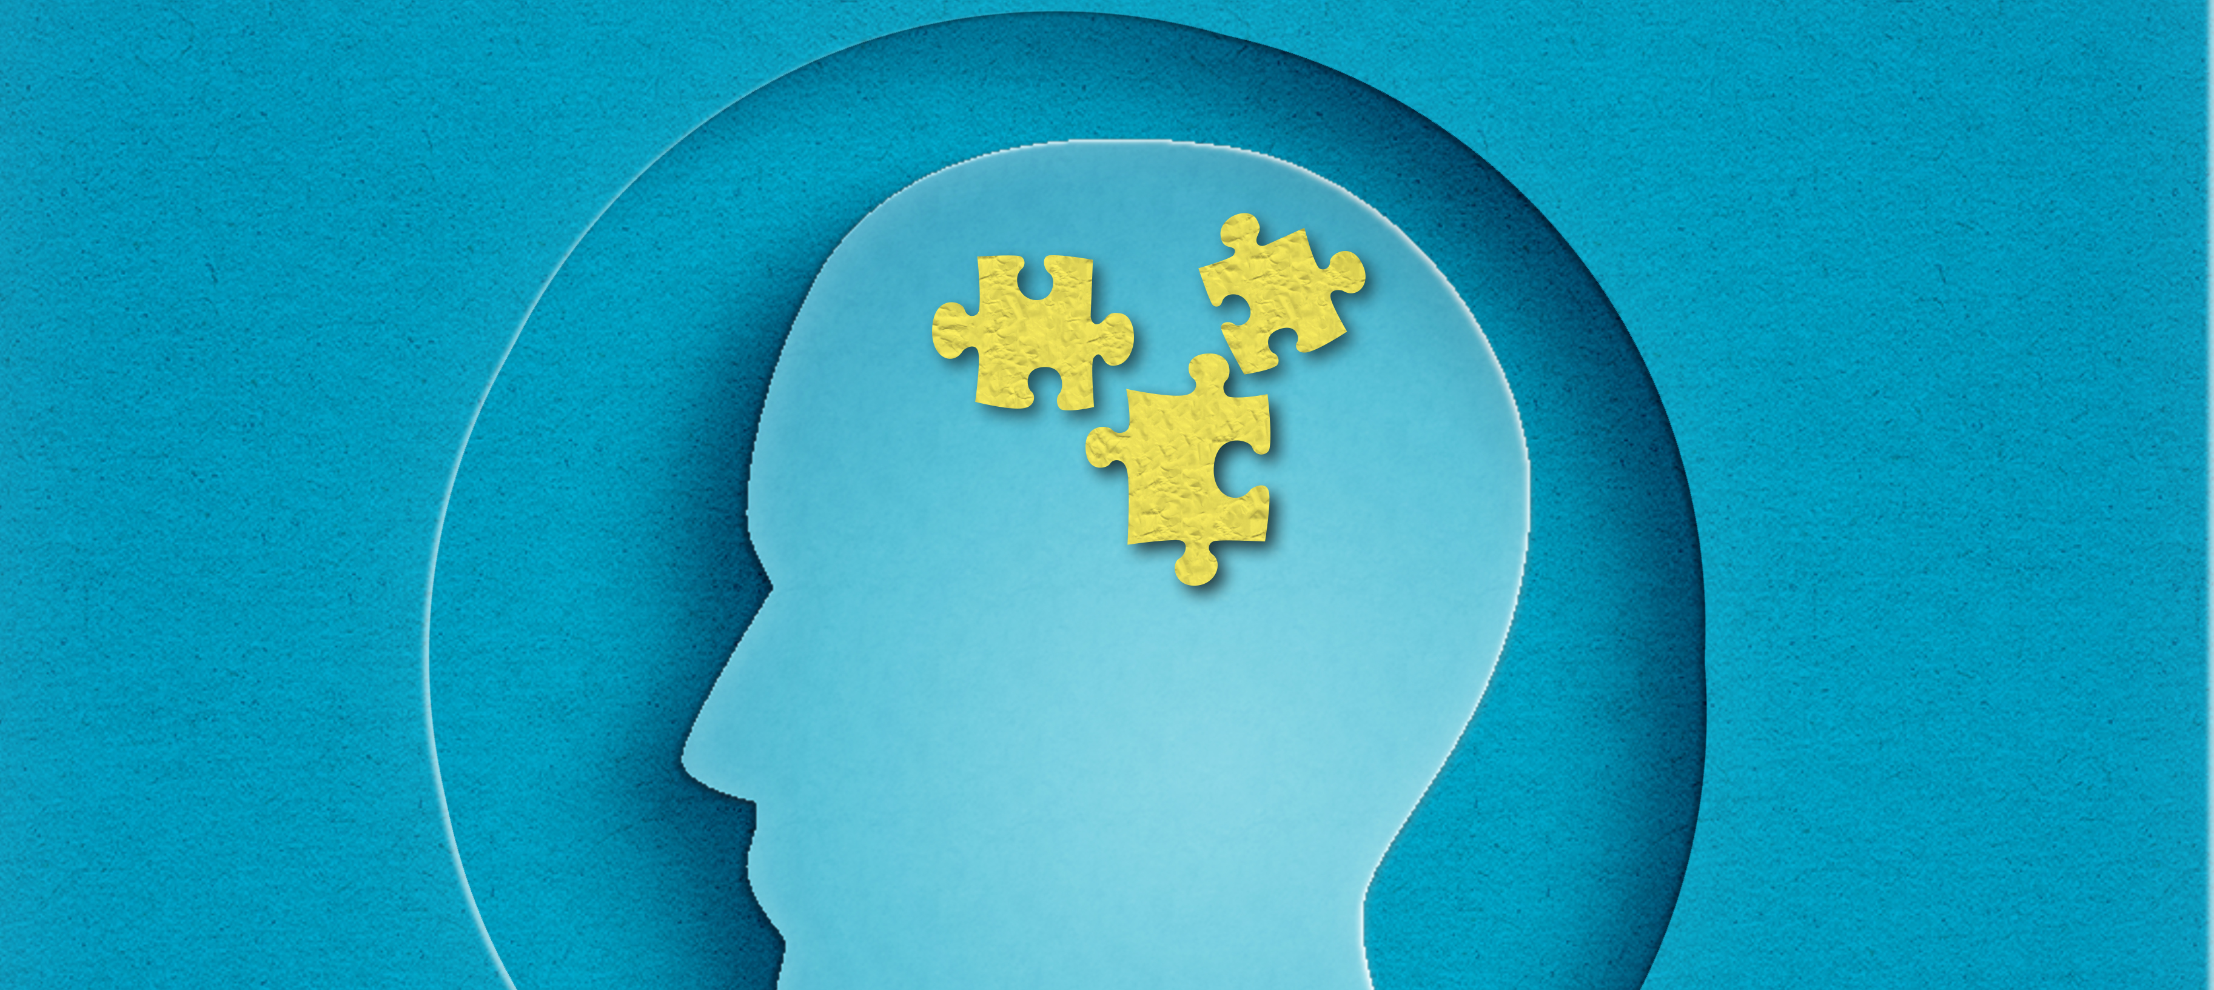
9. Examples

Slide 13


